Slide 1


Raytheon Senior Design Project Android Based Situational Awareness: Moving Map
Gate 5: Kickoff
September 19, 2012

Slide 2
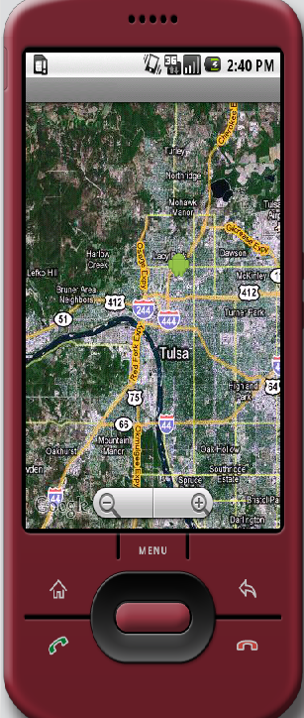
Project Overview
Background: There are no current Raytheon non-web based mapping applications on an Android device.
CONOPS: (Concept of Operations) The application is intended for soldiers, law enforcement officers, or other personnel without access to the Internet. The application will be compatible with Android devices.
Key Assumptions:
Raytheon will provide one 10” Samsung Galaxy Tablet
Critical Success Factors:
Selected a map engine by 9/26/2012
Screen shots of existing applications by 9/26/2012, and ask for screen shots of all required maps layers
Buyoff Criteria:
Final Release Demonstration for Raytheon Management
Successful completion of all university project requirements
Deliverables:
Program Documentation (Schedule, etc.)
Requirements/Architecture
System Design
Source Code/Executables
Demonstrations
Next Milestone:
System Reqs. Review (SRR) – 3 Oct 2012

Slide 3
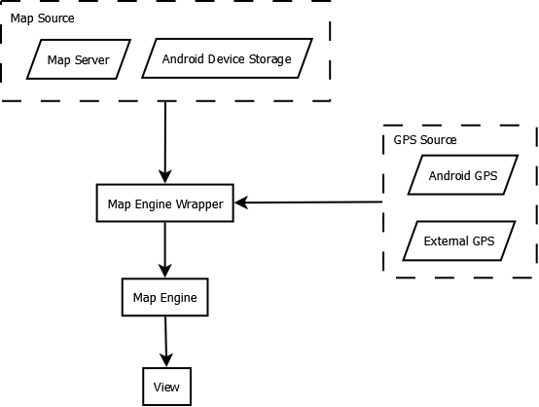
High Level Architecture

Slide 4

Existing Situational Awareness Software

Slide 5
Project Schedule & Milestones
System Requirements Review: September 26th
Preliminary Design Review: October 31st
Alpha Release: December 19th
Beta Release: February 6th
Critical Design Review: February 6th
Test Readiness Review: March 20th
Final Release: April 17th
Expo/Out brief: May 22nd

Slide 6
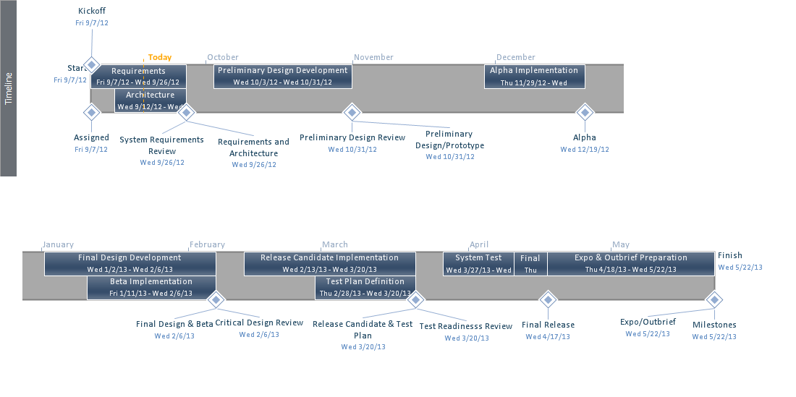
Project Schedule

Slide 7
Project Team
Todd Lovell
Chief Engineer
TBD
Subject Matter Expert
J.D. Hill
Program Engineer
Michael Wollowski
Project Advisor
Tom Atnip
Team Leader
Software Engineer
Susi Cisneros
Client Contact
Software Engineer
Sam Kim
Software Engineer
Seth Troisi
Software Engineer

Slide 8
Assumptions, Risks, & Opportunities
Risks
Find a mapping engine that supports Raytheon’s map format
Assumptions
There exists a mapping tool that provides the ability to perform basic functionality (e.g. panning, zooming)
Libraries for pulling mapping information from local server (e.g. Wifi, USB)
Opportunities
Google’s mapping engine may provide many required features

